Slide 1
CS 334 / CS 534 Networking
Lecture 02
History of Networking

Slide 2
What is a communications network even?!
A communications network is a network of links and nodes arranged so that messages may be passed from one part of the network to another
What is a node and a link?
People and roads
Telephones and switches
Computers and routers
What is a message?
information

Slide 3
What is a communications network even?!
Networks are key for:
Speed
Distance
A communications network is a network of links and nodes arranged so that messages may be passed from one part of the network to another
What is a node and a link?
People and roads
Telephones and switches
Computers and routers
What is a message?
information

Slide 4
Networks are Fundamental
Networks

Slide 5
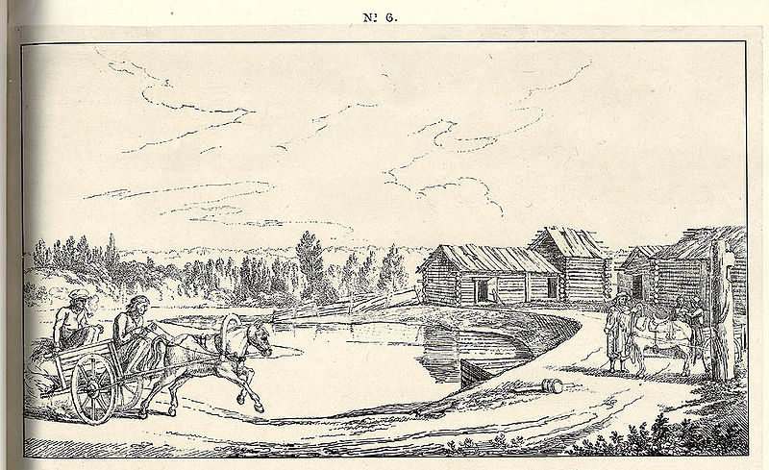
Networks are old
2400 BC: courier networks in Egypt
550 BC: postal service invented in Persia

Slide 6
Networks are old
Problems:
Speed
Reliability
Security
2400 BC: courier networks in Egype
550 BC: postal service invented in Persia

Slide 7
Towards Electric Communication
1837: Telegraph invented by Samuel Morse
Distance: 10 miles
Speed: 10 words per minute
In use until 1985!!!!
Key challenge: How to encode information?
Originally used unary encoding
A • B •• C ••• D •••• E •••••
Next generation: binary encoding
A •– B –••• C –•–• D –•• E •

Slide 8
Towards Electric Communication
Higher compression
→
Faster speeds!
1837: Telegraph invented by Samuel Morse
Distance: 10 miles
Speed: 10 words per minute
In use until 1985!!!!
Key challenge: How to encode information?
Originally used unary encoding
A • B •• C ••• D •••• E •••••
Next generation: binary encoding
A •– B –••• C –•–• D –•• E •

Slide 9


Telephony
1876: Alexander Grand Bell invents telephone
Key challenge: how to scale the network?
Originally, all phones directly connected!
O(n^2) complexity! n*(n - 1)/ 2 connections; yikes!
1878: Switching
1937: Trunk lines + multiplexing

Slide 10
Telephony
Advantages:
Easy to use
Switching mitigates complexity
Makes cable management tractable
Problems:
Manual switching :’(
1918: cross country call took 15 minutes to set up!
1876: Alexander Grand Bell invents telephone
Key challenge: how to scale the network?
Originally, all phones directly connected!
O(n^2) complexity! n*(n - 1)/ 2 connections; yikes!
1878: Switching
1937: Trunk lines + multiplexing

Slide 11
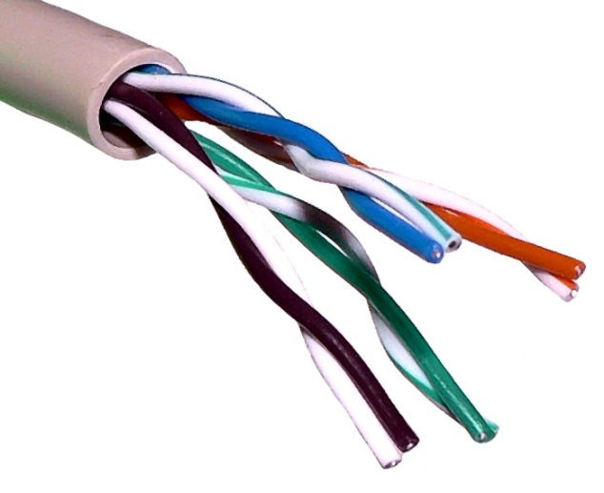

Growth of the Telephone Network
1881: Twisted pair for local loops
1885: AT&T Formed ☺
1892: Automatic telephone switches
1903: 3 million telephones in USA!
1915: First transcontinental cable
1927: First transatlantic cable
1937: First round-the-world call
1946: National numbering plan

Slide 12
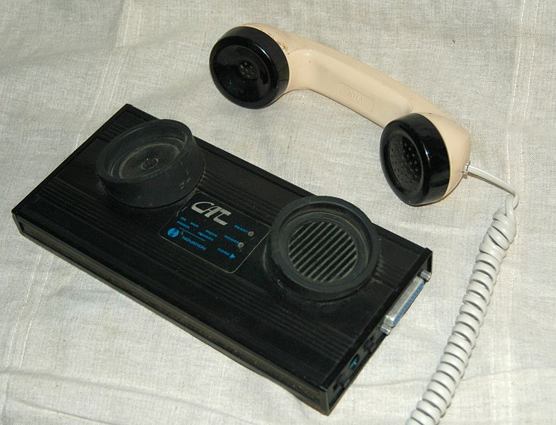
From Humans to Computers
1958: First use of a model
Machine-to-machine communication
Analog vs. digital signals
Many different computer networks
Local vs global
LAN, WAN
Private vs. public
Internet2, NIPRNet
General purpose vs. special purpose
E.g., credit cards, banks, defense
Technology
Satellite, copper, Fiber
Circuit vs packet switched

Slide 13
History of the Internet
1961: Kleinrock @ MIT: packet-switched-network
1962: Licklider’s vision of Galactic Network
1965: Roberts connects computers over phone line
1967: Roberts publishes vision of ARPANET
1969: BBN installs first InterfaceMsgProcessor at UCLA
1970: Network Control Protocol (NCP)
1972: Public demonstration of ARPANET
1972: Kahn @ DARPA advocates Open Architecture
1972: Vint Cerf @ Stanford writes TCP

Slide 14
Why Packet Switching?
Telephone networks are circuit switched
Each call reserves resources end-to-end
Provides awesome quality of service
Problems…
Resource intensive (idle circuit?)
Complex network components (per circuit state, security)
Packet Switching
No connection state, network is store-and-forward
Minimal network assumptions
Statistical multiplexing gives high overall utilization

Slide 15
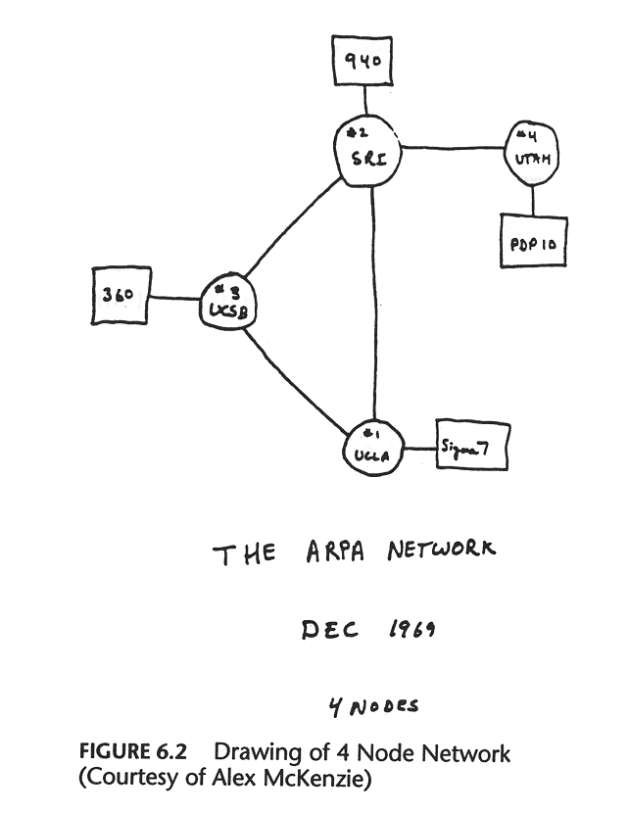

Slide 16
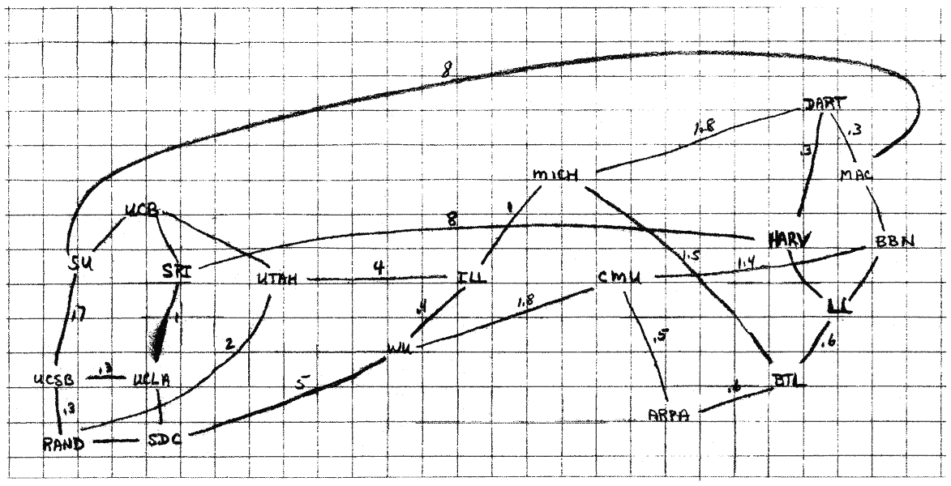
The 1960s

Slide 17
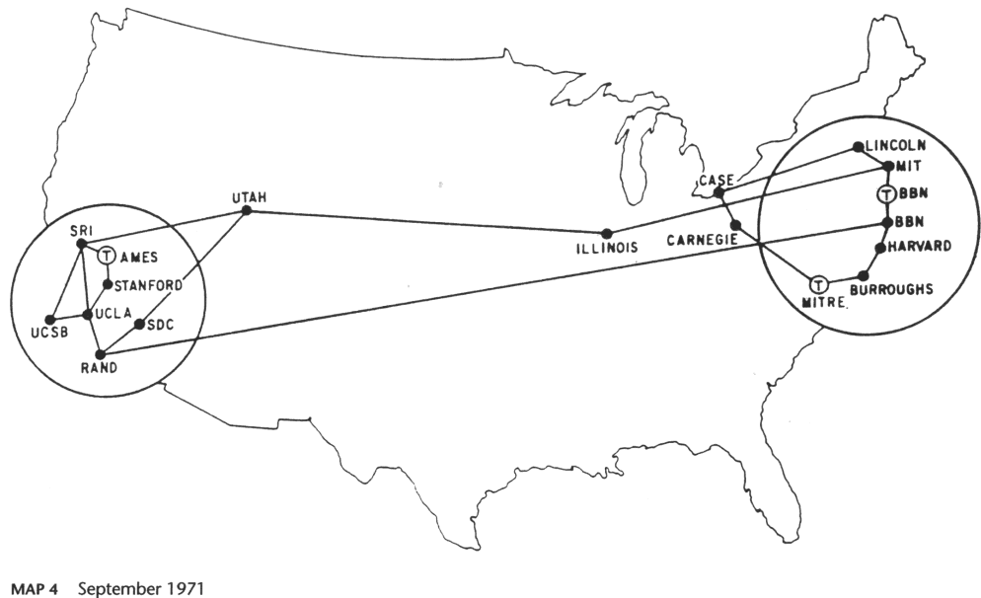
1971

Slide 18
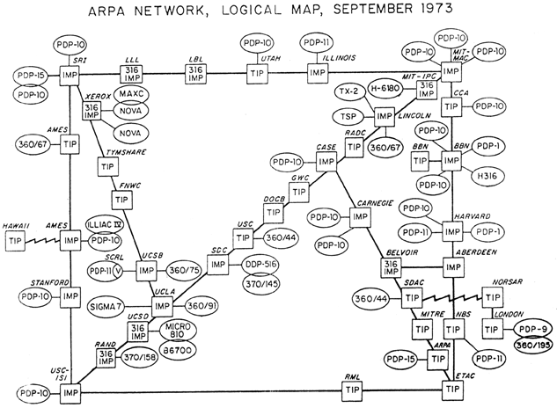
1973
Notes:
Interface Message Processor – packet switching node. Today it is a router.
Terminal Interface Processor (TIP), which provided terminal server support for up to 63 ASCII serial terminals through a multi-line controller in place of one of the hosts
PDP-10 – OLLLD Mainframe.
NORSAR becomes the first non-US node on ARPANET, the predecessor to today's Internet. SATNET (Atlantic Packet Satellite Network)

Slide 19

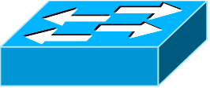
Growing Pains
Problem: Early networks used incompatible protocols

Slide 20
(Robert) Kahn’s Ground Rules
Each network is independent, cannot be forced to change
Best-effort communication (i.e., no guarantees)
Routers connect networks
No global control
Principals behind development of IP
Lead to the Internet as we know it
Internet still structured this way (for most part…)
Notes:
Algorithms to prevent lost packets from permanently disabling communications and enabling them to be successfully retransmitted from the source.
Providing for host to host "pipelining" so that multiple packets could be enroute from source to destination at the discretion of the participating hosts, if the intermediate networks allowed it.
Gateway functions to allow it to forward packets appropriately. This included interpreting IP headers for routing, handling interfaces, breaking packets into smaller pieces if necessary, etc.
The need for end-end checksums, reassembly of packets from fragments and detection of duplicates, if any.
The need for global addressing
Techniques for host to host flow control.
Interfacing with the various operating systems
There were also other concerns, such as implementation efficiency, internetwork performance, but these were secondary considerations at first.

Slide 21

The Birth of Routing

Slide 22
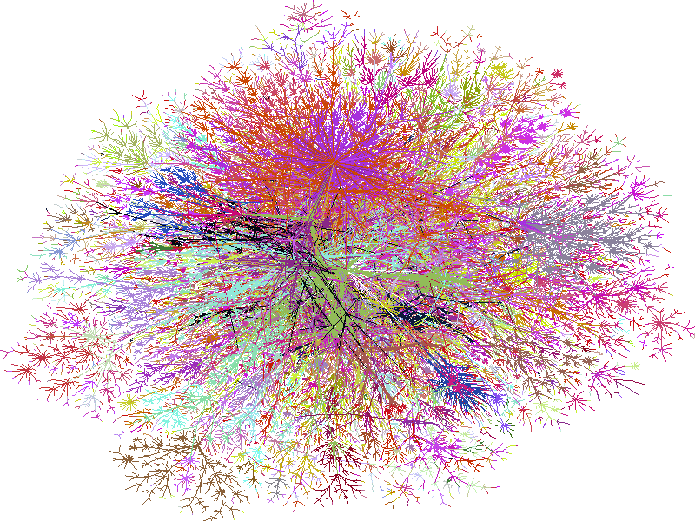
2000

Slide 23
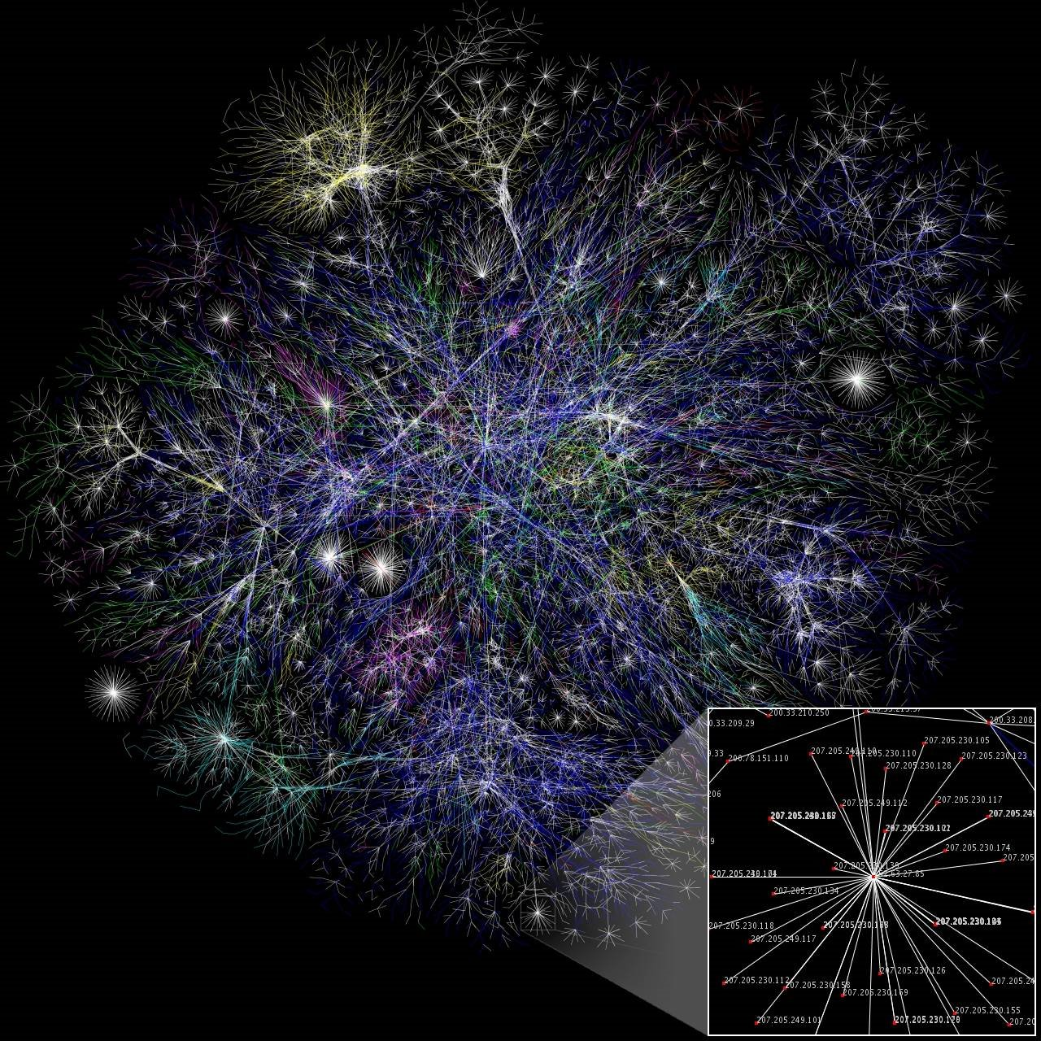
2006

Slide 24

2009

Slide 25
More Internet History
1974: Cerf and Kahn paper on TCP (IP kept separate)
1980: TCP/IP adopted as defense standard
1983: ARPANET and MILNET split
1983: Global NCP to TCP/IP flag day
198x: Internet melts down due to congestion
1986: Van Jacobson saves the Internet (BSD TCP)
1987: NSFNET merges with other networks
1988: Deering and Cheriton propose multicast
199x: QoS rises and falls. ATM rises and falls
1994: NSF backbone dismantled; private backbone
200x: The Internet boom and bust
Notes:
ARPANET and MILNET split to remove military components from ARPANET
JAN 1 1983 – “flag day” -> marked the start of the modern internet
BSD TCP – Berkeley Sockets library for bind, listen, accept, connect etc.etc.
Deering and Cheriton – multicast RFC 966
NSFNET went online in 1986 and connected the supercomputer centers at 56,000 bits per second. NSF and Domain Names. Funded by Military, because so many DoD uses. Growth rate too high.

Slide 26
More Internet History
What’s next?!
1974: Cerf and Kahn paper on TCP (IP kept separate)
1980: TCP/IP adopted as defense standard
1983: ARPANET and MILNET split
1983: Global NCP to TCP/IP flag day
198x: Internet melts down due to congestion
1986: Van Jacobson saves the Internet (BSD TCP)
1987: NSFNET merges with other networks
1988: Deering and Cheriton propose multicast
199x: QoS rises and falls. ATM rises and falls
1994: NSF backbone dismantled; private backbone
200x: The Internet boom and bust

Slide 27
Internet Applications Over Time
1972: Email
1973: Telnet – remote access to computing resources!
1982: DNS – “phonebook” of the Internet
1985: FTP – remote file access
1989: NFS – remote file systems
1991: The World Wide Web (WWW) goes public
1995: SSH – secure remote shell access
1995-1997: Instant messaging (ICQ, AIM)
1998: Google
1999: Napster, birth of P2P
2001: Bittorrent
2004: Facebook
2005: Youtube
2007: The iPhone

Slide 28
Internet Applications Over Time
What’s next?!
1972: Email
1973: Telnet – remote access to computing resources!
1982: DNS – “phonebook” of the Internet
1985: FTP – remote file access
1989: NFS – remote file systems
1991: The World Wide Web (WWW) goes public
1995: SSH – secure remote shell access
1995-1997: Instant messaging (ICQ, AIM)
1998: Google
1999: Napster, birth of P2P
2001: Bittorrent
2004: Facebook
2005: Youtube
2007: The iPhone

Slide 29
Takeaways
Communication is fundamental to human nature
Key concepts are very old
Speed/bandwidth
Encoding
Latency
Switching
Multiplexing
Routing
Cable management
Packets vs circuits

Slide 30
Takeaways
The Internet has changed the world
Communication is now basically free ($) and Free (freedom)
Shrunk the world
Completely changed the way we interact with each other
Has greatly increased overall productivity
Kinda funny considering we waste so much time online ;)
Key to growth: open networks with simple API’s

